Slide 1
Greensaw Design & Build: Emergence of a Worker Cooperative
Dottie Ives-Dewey, Ph.D., AICP
Associate Professor & Chair
Geography & Planning Department
West Chester University

Slide 2
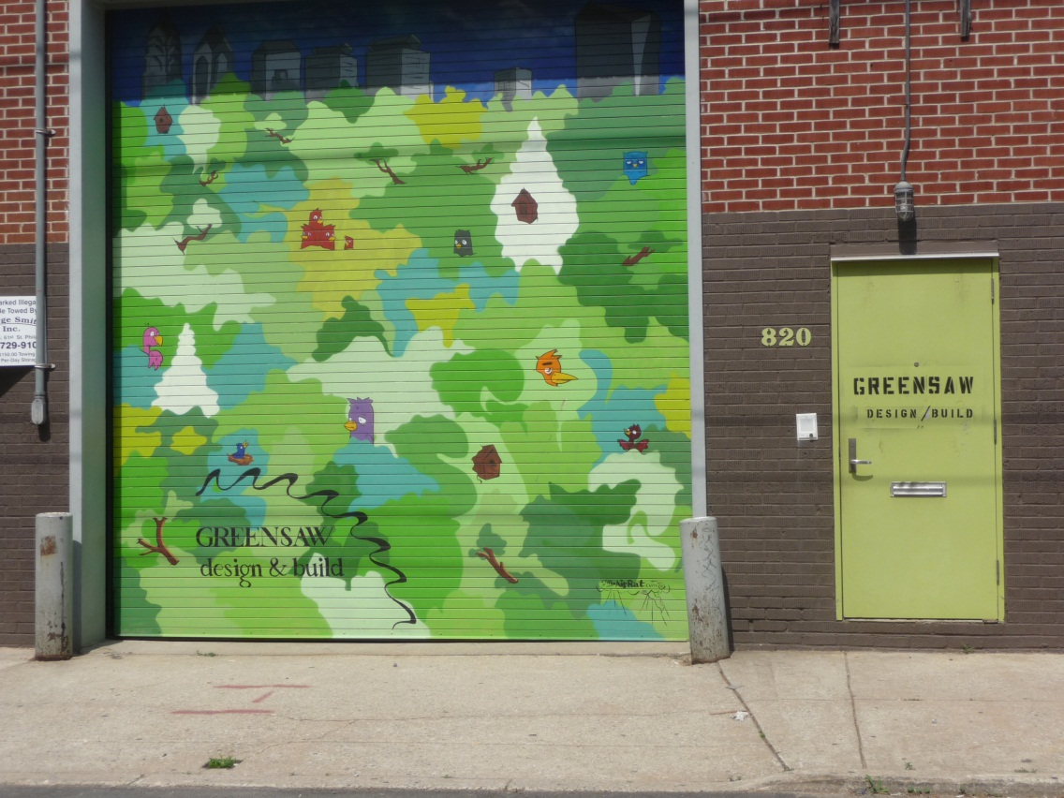
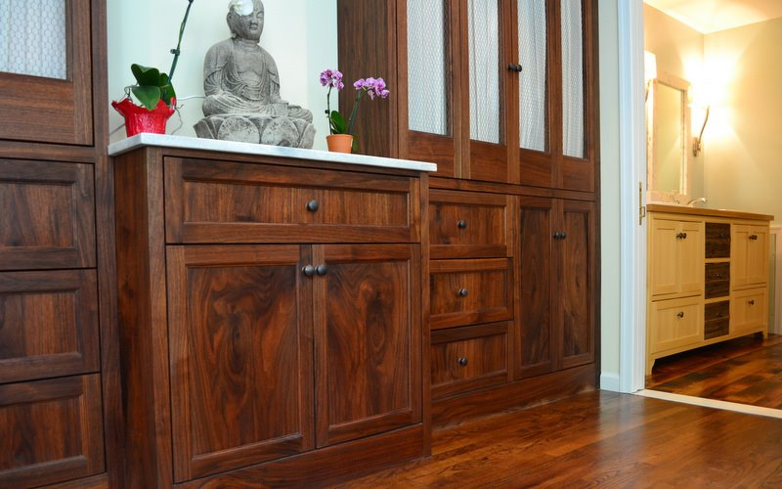
Company Overview
Greensaw is a Worker Cooperative located in Northern Liberties, Philadelphia
Core business – installation of architectural salvage for custom residential and commercial renovations
Established in 2006, converted to a worker co-op in 2011
Notes:
Perhaps the first worker cooperative in Philadelphia
Salvage materials from demolitions/renovations, refinish them, install into custom residential and commercial renovations
Operating for one year as a worker co-op.
Their early experience provides insight into the myriad issues – legal, personal, business and otherwise – that a company is likely to face in making the transition to a cooperative

Slide 3
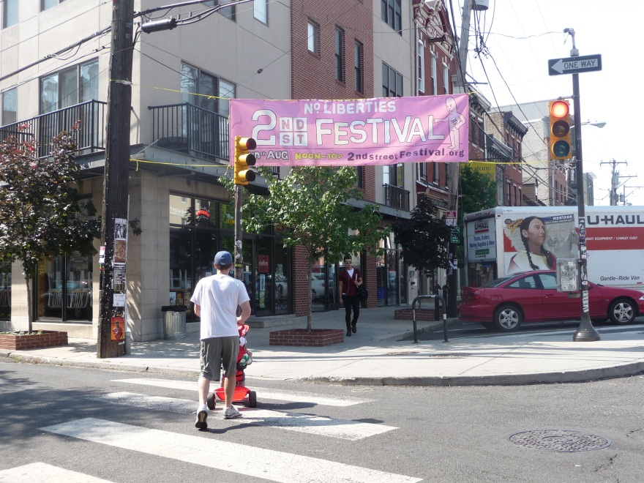
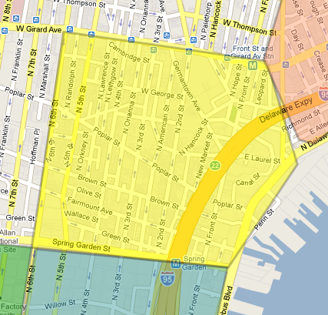
Northern Liberties
Notes:
Roughly the area north of Spring Garden, south of Girard; between 6th Ave and Penn St.
Adjacent to Old City to the south.
Gentrified neighborhood – once dominated by industrial breweries and other manufacturing uses, the neighborhood is now an enclave of young professionals, students and artists
Property values have seen a big jump

Slide 4
Core Principles
Green Building
Client Collaboration
Quality Craftsmanship
Workplace Democracy
Community Relationships
Greensaw supports the environment, their employees, the green building industry and their local economy
Notes:
Using reclaimed materials is about as green as it gets. Minimizes waste and materials ending up in the landfill.
They also employ green technologies – solar panels, radiant floors, non-VOC paints, tankless water heaters
Known for high valued customer service
Nurture relationships with other companies in the local green building industry and they support community development efforts in Northern Liberties.
Principles reinforce one another

Slide 5
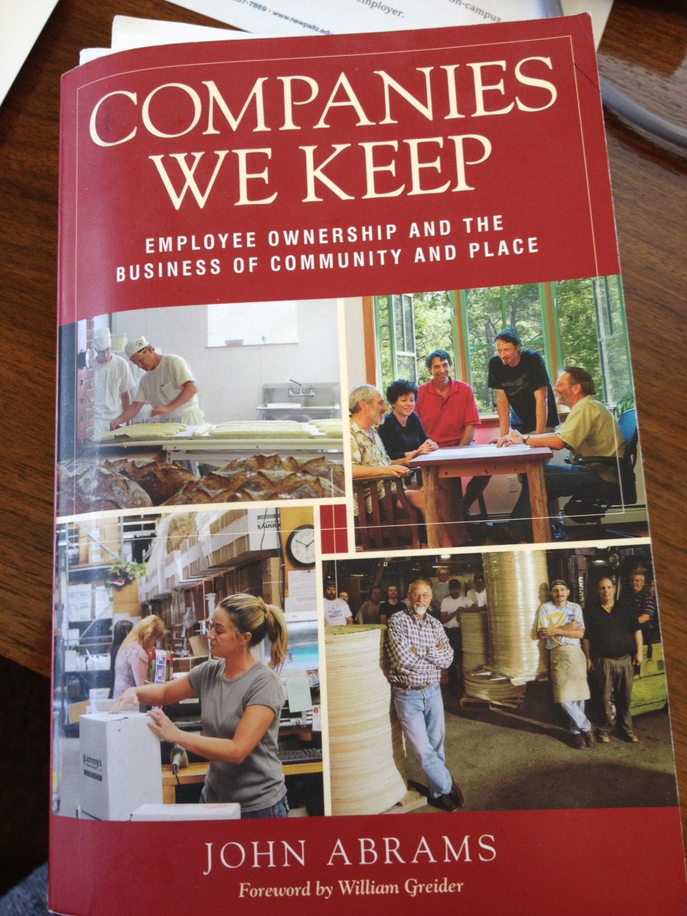
Background
Greensaw originally founded by one individual, Brendan Jones in 2006
Inspired by the experience of the South Mountain Company in Martha’s Vineyard
Model resonated with Jones as a way to appropriately recognize and reward talented employees and formalize existing company practices and to free himself from day-to-day management responsibilities
Notes:
Jones wanted an approach with his company that was more sustainable and humanistic

Slide 6
Two year transition process
Founder’s Committee formed in 2009
Fundamental decisions:
Crafting governance and management structures
Establishing membership rights and responsibilities
Determining path to Membership
Etc.
Modeled much of their structure after the South Mountain Company
Notes:
Buy-out arrangement -- $100,000 payment to Jones. Employees could buy-in for an amount of $3,500 over 7 years ($500 installments)
New owners chosen and invited by a consensus of existing owners after minimum of 3 years of employment

Slide 7
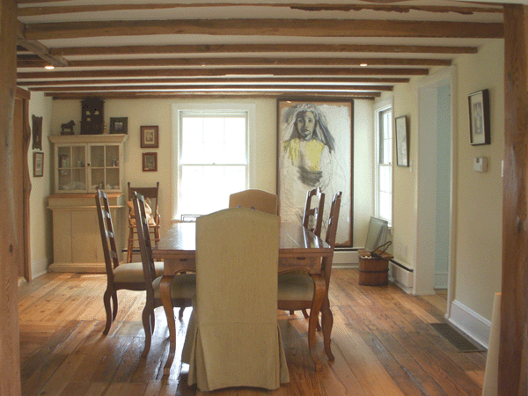
Company Profile
14 employees
One additional owner-member since the conversion
Market is still mostly Philadelphia
Slowly moving into the suburbs
Reported revenues in 2011: $1.5 m
Notes:
Employees include carpenters, designers, craftspeople, office staff
Market is largely local – Philadelphia and increasingly the suburbs

Slide 8
Start-up Challenges
Substantial up-front costs to make the conversion
Legal, financial and accounting
Sharing risk and reward
Unsteady revenues
Personal liability for outstanding debt by new owners
Back-tracking losses to new owners
Attracting new owners
Personality and interpersonal dynamics
Notes:
Attracting new members has been a challenge – perceptions of risk, understanding liabilities, concern over interpersonal differences, trust
Company relies on outstanding loans and a line of credit – unclear how existing debt is assigned to new owners

Slide 9
Preliminary Conclusions
Great potential model – sustainability, workplace democracy, and commitment to community are reinforcing principles
Worker co-ops take time and resources – transition period can be long and expensive
Key individuals to champion the process
Resources to help with the transition
Two essential pillars – trust and profitability
Notes:
Greensaw provides a great example of what a worker cooperative can be.
Their experience demonstrates that quality craftsmanship and reduced impact on the environment can serve as the foundation of a viable business model. And the cooperative model can directly benefit not only employees but the community as well.
As a cooperative they function better as a business. Hard to say whether the cooperative model makes them more attractive to customers, probably the higher quality products that come from the model.
Community development efforts become a by-product
Worker cooperatives evolve over time
Need support through the transition period – funding for legal and accounting services
Need one or more champions to lead the transition
Legal and accounting assistance – otherwise costs can be prohibitive
Ultimately the coop needs to make a sufficient profit to stay in business

Slide 10
Thank you….
Dottie Ives-Dewey
divesdewey@wcupa.edu

